Slide 1
EMPLOYEE RETENTION
By Yatharth Bali

Slide 2

Agenda
The purpose of this employee retention project is to develop and implement strategies that enhance employee satisfaction, reduce turnover, and foster a supportive work environment. By addressing key factors such as career growth, compensation, recognition, and work-life balance, the project aims to create a workplace where employees feel valued and motivated to contribute to the organization's success. This initiative will not only help preserve institutional knowledge and reduce recruitment costs but also improve productivity, morale, and the overall employer brand. Ultimately, the project seeks to align employee well-being with organizational goals, ensuring long-term sustainability and growth.

Slide 3
Content:
II011
Introduction
DATA GATHERING/DATA REFINEMENT
1
2
EXPOLATORY DATA ANALYSIS
FEATURE EXTRACTION
3
4
TREATING OUTLIERS
ALGORITHIMS
5
6
EXPERIMENTAL RESULTS
CONCLUSION
7
8

Slide 4
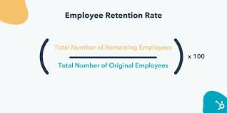
Introduction:
Employee retention refers to an organization's ability to retain its employees over a period of time and minimize turnover. It involves creating a positive and supportive work environment, addressing employees’ needs, and implementing strategies that encourage employees to stay with the company.
Employee retention is critical to an organization's success. A focused and proactive approach to understanding employee needs, fostering a positive work culture, and providing growth opportunities helps organizations retain top talent, reduce costs, and drive long-term business performance.

Slide 5


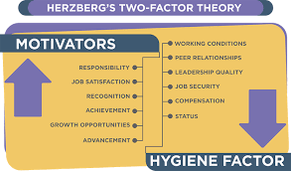



Key Benefits:
Stronger Employer Brand
Preserved Institutional Knowledge
Improved Employee Morale
Enhanced Productivity
Cost Savings

Slide 6
Data Gathering:
19,158
Feature Columns
ROWS
14
Train_Dataset
2,129
COLUMNS
enrollee_id
city
city_development_index
gender
ROWS
relevant experience
13
enrolled_university
education_level
Test_Dataset
major_discipline
company_size
COLUMNS
company_type
last_new_job
training_hours
target

Slide 7
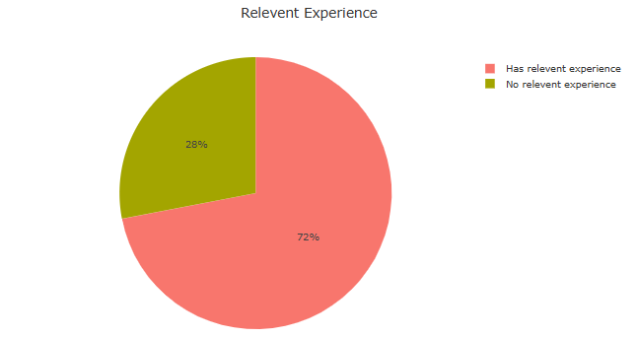
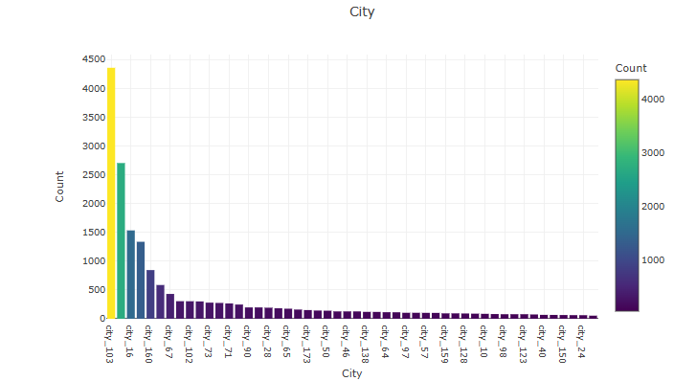
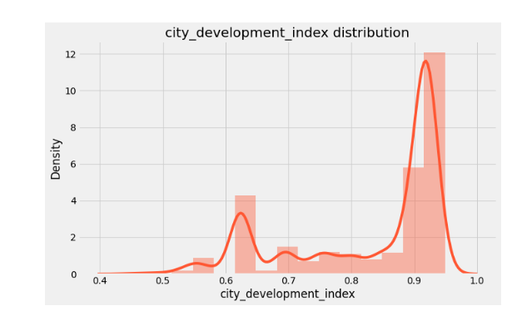
EXPLORATORY DATA ANALYSIS
Exploratory Data Analysis (EDA) helped us understand the data structure, find patterns, identify trends, and gain valuable insights from the dataset.
From EDA we analyze, the distribution of each features .
Using visuals helped us see the data clearly, understand the EMPLOYEE data relationship with each other, and pinpoint factors that plays vital role in predictions of EMPLOYEE RETENTION.
The datasets is NEED TO clean , but we can find some DUPLICATE VALUES and OUTLIERS.
We looked at our data columns and found SOME columns to be numerical in terms of data types, but they are categorical in terms of semantic. So, we converted them to object for proper analysis.

Slide 8
Key STEPS IN EDA
1. Data Collection
Importing data from various sources (CSV, Excel, Database).
2. Data Cleaning
Handling missing values.
Removing duplicates.
Data Type Conversion: Ensure each column has the correct data type.

Slide 9
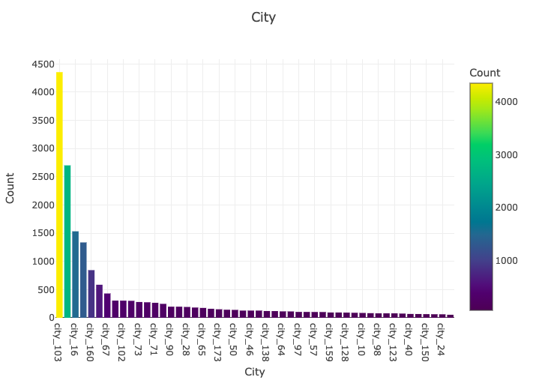
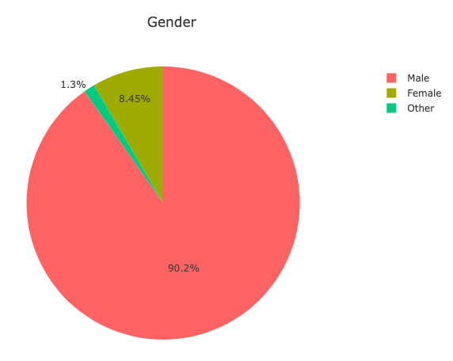
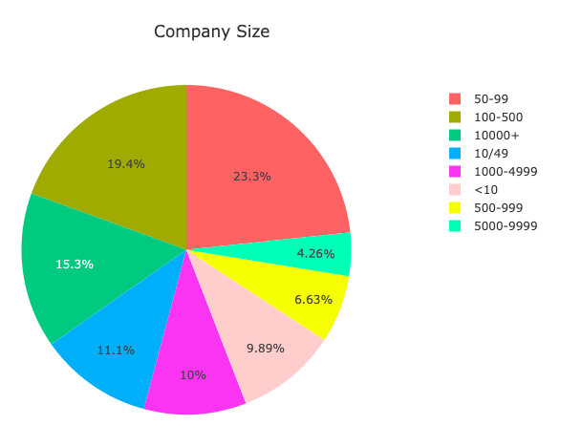
3. Plot with categorial variables
4. Plot with numerical variables

Slide 10
Feature extraction
Feature extraction is the process of creating new features or transforming existing ones from raw data to improve the performance of machine learning algorithms.
Why It’s Needed:
Raw Data: Often too complex or high-dimensional to directly apply machine learning algorithms.
Extracted Features: More compact, informative, and easier for models to understand.

Slide 11
FEATURE EXTRACTION
DROPPING UNUSEFUL FEATURES FROM DATA SET : When working with a dataset, dropping unimportant or redundant features is a crucial part of the data preprocessing process. Removing such features helps improve the performance of machine learning models, reduces overfitting, and makes the models more interpretable.
SCALING THE DATASET LIKE STANDARDSCALER : To scale your dataset like StandardScaler in machine learning, you essentially perform standardization, which transforms your features so that they have a mean of 0 and a standard deviation of 1.

Slide 12
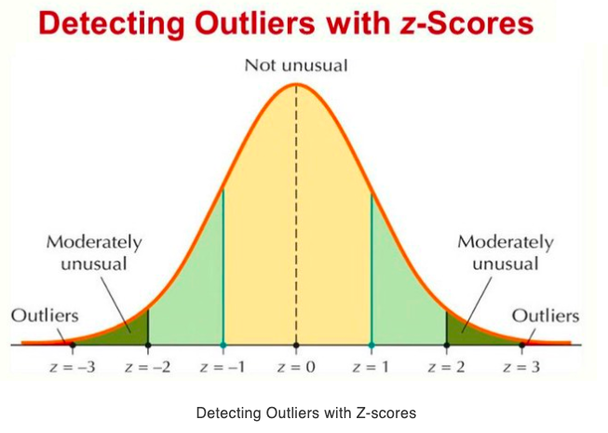


TREATING OUTLIERS
Outliers are data points that differ significantly from other observations in the dataset.
Key Characteristics:They are unusually high or low compared to other values.
Can skew statistical analysis and lead to misleading results.

Slide 13
DETECTING OUTLIERS
Visual Methods:
Box Plot: Shows the spread and identifies outliers as points outside the whiskers.
Histogram: Identifies outliers based on extreme values in the tails.
Scatter Plot: Helps in detecting outliers in relationships between two variables.
Statistical Methods:
Z-Score: Measures how far away a data point is from the mean in terms of standard deviations (typically, values above |3| are considered outliers).
IQR (Interquartile Range): Data points outside 1.5 times the IQR above Q3 or below Q1 are outliers.

Slide 14
TRAIN TEST SPLIT
We divided the data into training (80%) and testing (20%) sets.
Setting a random state ensures consistent results and using stratify=y maintains a proportional distribution of the target variable in both sets.
SPLITTING THE DATA INTO X & Y
We divided the dataset into two parts: X and y.
"X" typically represents the independent Variables, and "y" represents the Dependent (target variable) that we want to predict or understand.

Slide 15
ALGORITHIMS
Logistic Regression : is a statistical method used for binary classification problems, where the output is categorical and typically takes one of two possible outcomes. It is particularly used for predicting probabilities and is foundational in machine learning.
Gradient Boosting :is a powerful ensemble learning technique used for both regression and classification tasks. It builds a model incrementally by training weak learners (typically decision trees) sequentially, where each new tree corrects the errors made by the previous ones.

Slide 16
Random Forest : is a versatile and powerful ensemble learning algorithm that can be used for both classification and regression tasks. It builds multiple decision trees during training and outputs the class that is the most common class (for classification) or the average (for regression) of the individual trees' predictions. Random Forest is a type of bagging algorithm and is known for its robustness, accuracy, and ease of use.

Slide 17
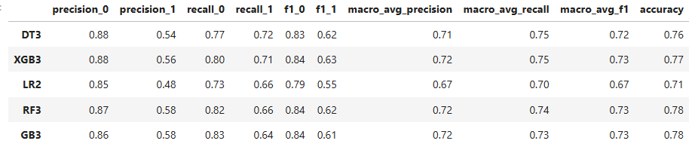
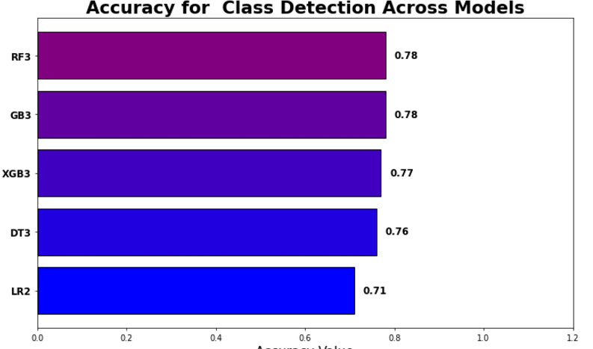
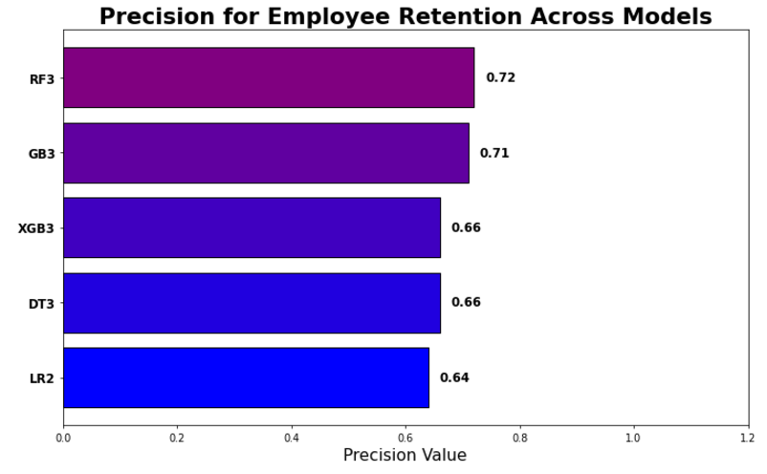
EXPERIMENTAL RESULTS

Slide 18
CONCLUSION
Employee retention is a critical factor in ensuring organizational stability, productivity, and long-term success. High turnover rates can result in significant financial and operational challenges, including increased recruitment costs, loss of institutional knowledge, and reduced morale among remaining employees.To address these challenges, organizations should focus on building a positive work environment that fosters engagement and satisfaction. Key strategies include providing competitive compensation, recognizing and rewarding employee contributions, offering opportunities for professional growth, and fostering open communication channels.Additionally, understanding the individual needs and motivations of employees through regular feedback and surveys can help tailor retention strategies to the workforce. Organizations that prioritize retention not only strengthen their teams but also position themselves as desirable employers in a competitive job market.By proactively investing in employee retention, businesses can enhance their overall performance and create a culture of loyalty and commitment that drives sustainable growth

Slide 19
Questions ?

Slide 20
Thank You!

